Slide 1
SEM 11
Flyweight
Strategy
Proxy

Slide 2
FLYWEIGHT
DP Structural

Slide 3
Flyweight – General principles
The solution is formed out of a very big number of memory costly objects
The objects are formed out of a sharable part(intrinsic) and an un-sharable part(extrinsic)
“Use sharing to support large numbers of fine grained objects efficiently”
(The GoF)

Slide 4
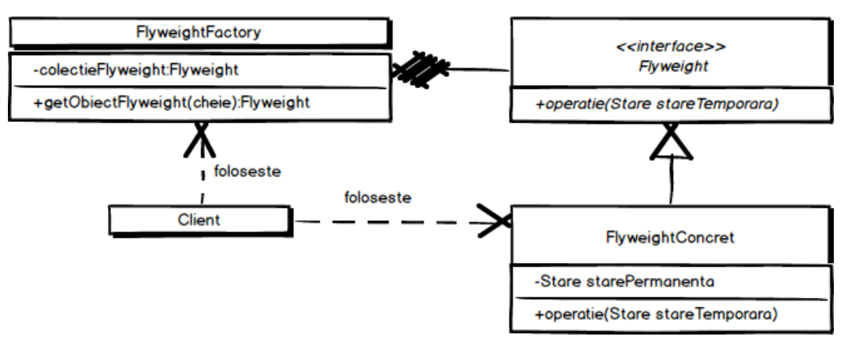
Flyweight - Diagram

Slide 5
Flyweight – Example
Inside the pizza restaurant a new module for managing the printing of the bills is needed.
The information stored inside a bill is given by: the name of the restaurant, the address and the total amount of the consumption that the clients need to pay for.
Also, in terms of marketing strategy, to each bill, randomly, a specific format is chosen in order to make the bill funnier.
The module needs to be optimal in terms of memory usage when a very big number of bills are generated.

Slide 6
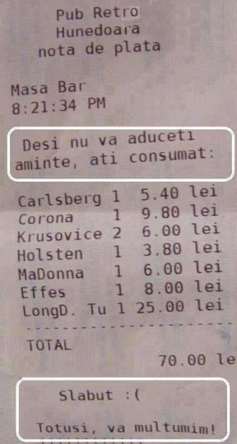

Bill examples

Slide 7

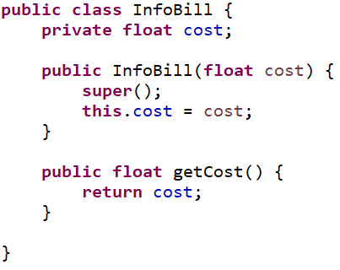
Flyweight – Example

Slide 8
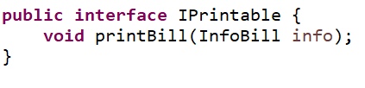
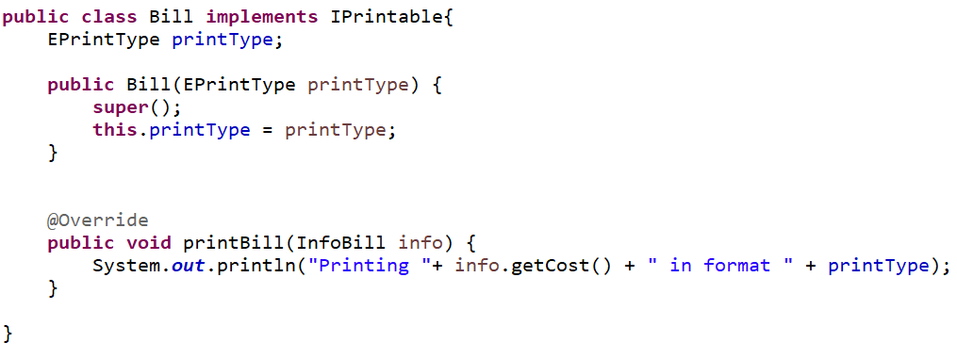
Flyweight – Example

Slide 9
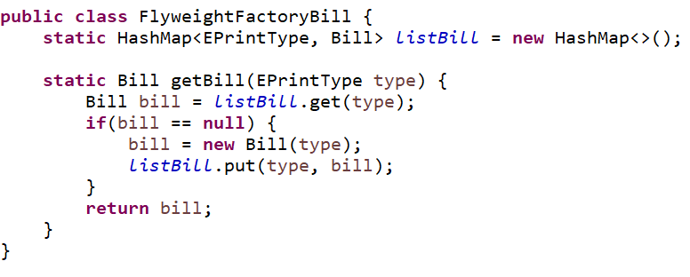
Flyweight – Example

Slide 10
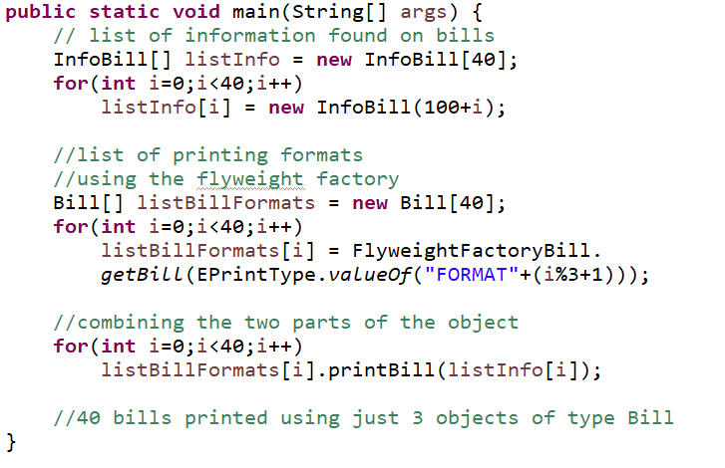
Flyweight – Testing

Slide 11
STRATEGY
DP Behavioral

Slide 12
Strategy – General principles
Choosing at run time the algorithm/function to use in order to obtain the result

Slide 13
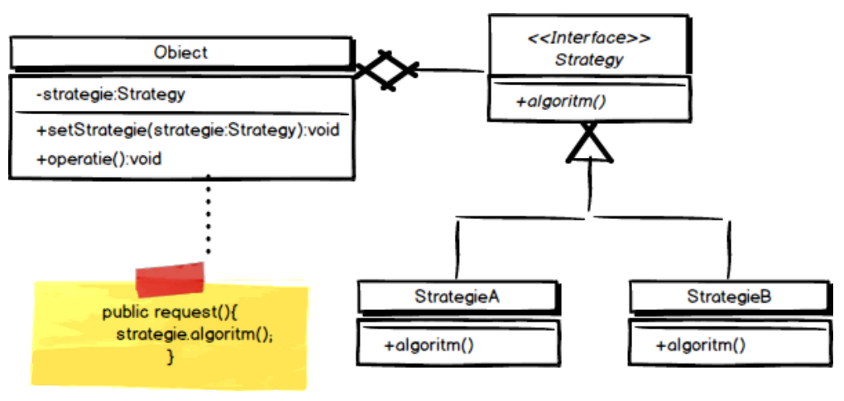
Strategy - Diagrame

Slide 14

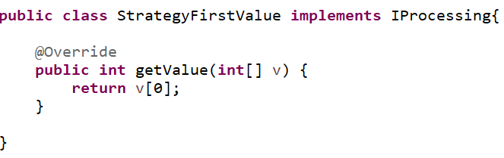
Strategy – Example

Slide 15
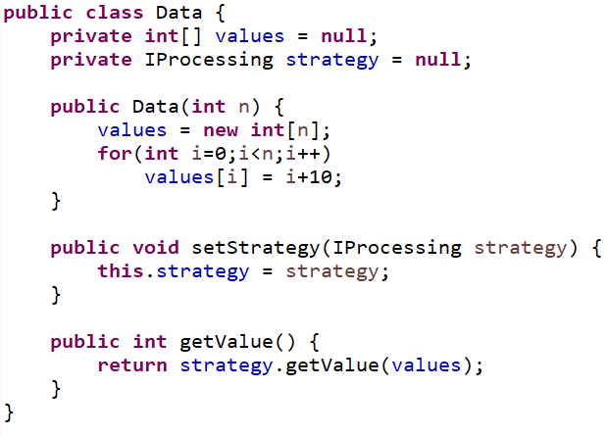
Strategy – Example

Slide 16
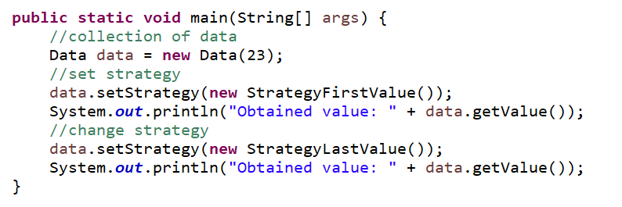
Strategy – Testing

Slide 17
PROXY
DP Structural

Slide 18
Proxy – General principles
Proxy – Controls and manages the access to the real object
Proxy – offers a barrier between the client and the real object
“Allows for object level access control by acting as a pass through entity or a placeholder object. ”
(The GoF)

Slide 19
Proxy – General principles
When to use
When the real object is external to the system
When objects are created on command
When you need controlled access to the real object
Adding new functionalities when accessing the object

Slide 20
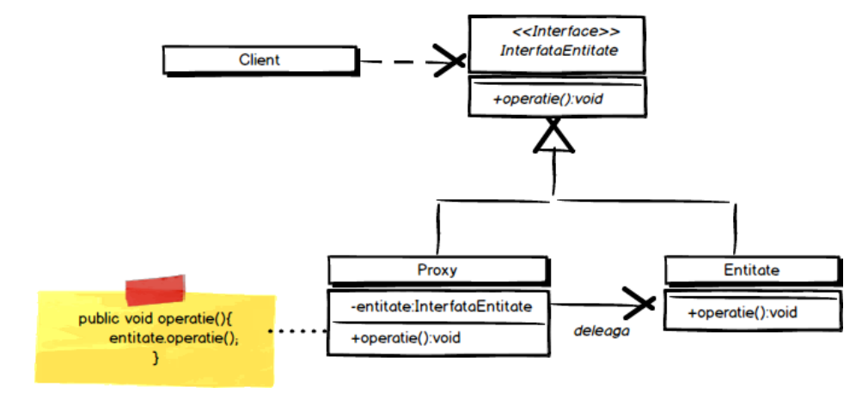
Proxy - Diagram

Slide 21

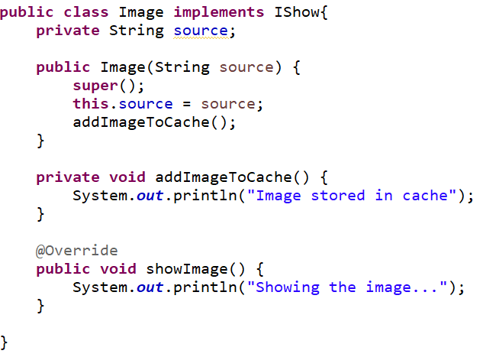
Proxy – Example

Slide 22
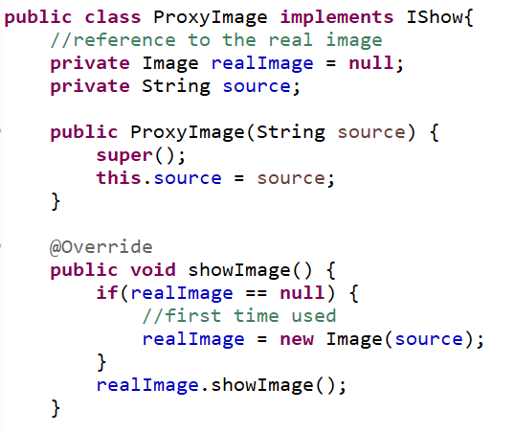
Proxy – Example

Slide 23
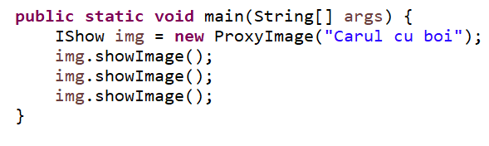
Proxy – Testing

